Slide 1
Project Meeting
2018.11.28

Slide 2




Structure
Cloud
Fog
Sensor

Slide 3



Architecture
Cloud
Deep Learning
Training Environment
Bockchain hash data
Bockchain hash data
anomaly alarm
DNN new model
anomaly alarm
DNN new model
original data
original data
container
container
Node
MQTT Broker
DNN Model
sharing ledger
MQTT Broker
DNN Model
Blockchain
Blockchain
sensor data
sensor data
Smart Meter Simulator
Smart Meter Simulator
Smart Meter Simulator
……
Sensor

Slide 4
Gateway
Raspberry Pi
LoRa
antenna
container
MQTT
Broker
LoRa
Gateway
Bridge
Message
Management program
Transmis-sion
after
DNN
program
DNN
Model
Data anomaly
behavior
program
BlockChain
Notes:
LoRa channel: 台灣使用920∼925MHz頻段的923MHz
LoRa Gateway Bridge is a service which abstracts the packet-forwarder UDP protocol into JSON over MQTT

Slide 5
peer = container
organization
Msg
ID
Time
Power consumption
Peer 0
Peer 1
Peer 2
DNN Model
.
.
.
Peer N
Notes:
行程間通訊（IPC，Inter-Process Communication）
指至少兩個行程或執行緒間傳送資料或訊號的一些技術或方法。 行程是電腦系統分配資源的最小單位(嚴格說來是執行緒)。 每個行程都有自己的一部分獨立的系統資源，彼此是隔離的。 為了能使不同的行程互相存取資源並進行協調工作，才有了行程間通訊。
Message queue, semaphore, and shared memory

Slide 6
Thanks

Slide 7
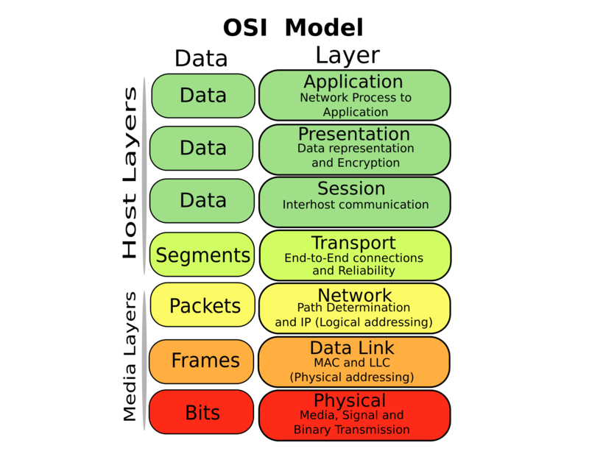
Open Systems Interconnection

Slide 8
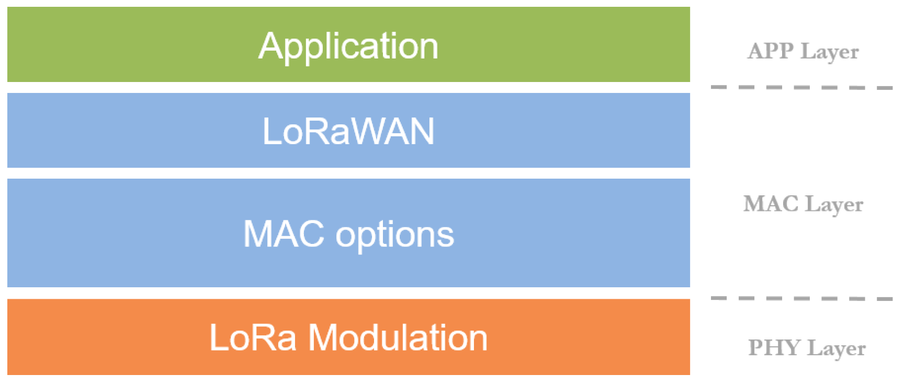
Long Range Wide Area Network (LoRaWAN) stack.

Slide 9
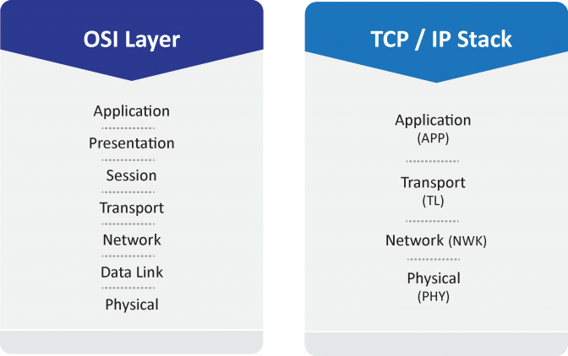
Traditional OSI stack and TCP/IP stack
Notes:
OSI (Open Systems Interconnection)

Slide 10
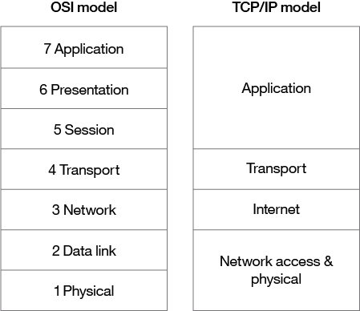
OSI vs TCP/IP model

Slide 11
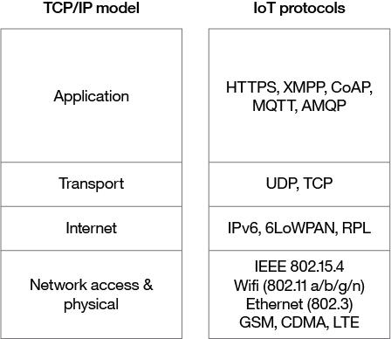
TCP/IP vs IoT protocols

Slide 12
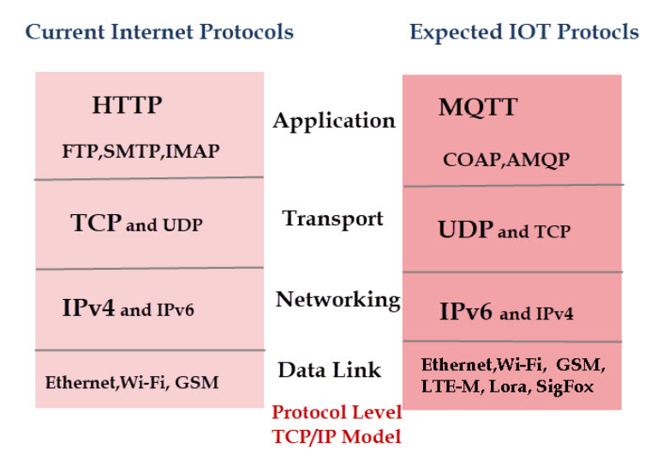
IoT and Internet Protocols

